Slide 1



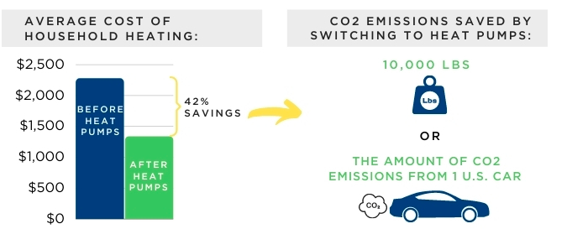
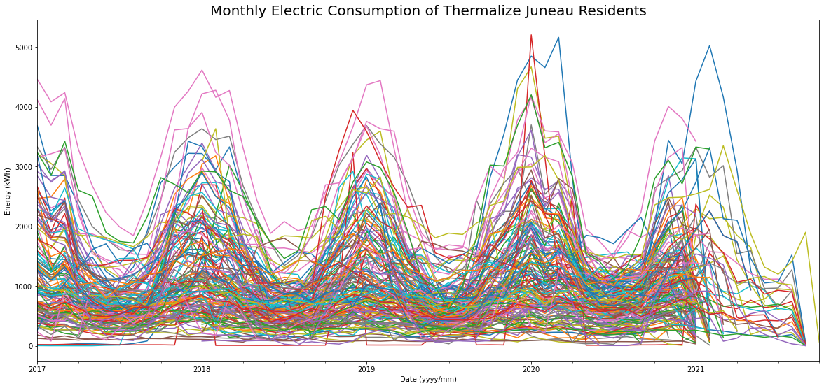
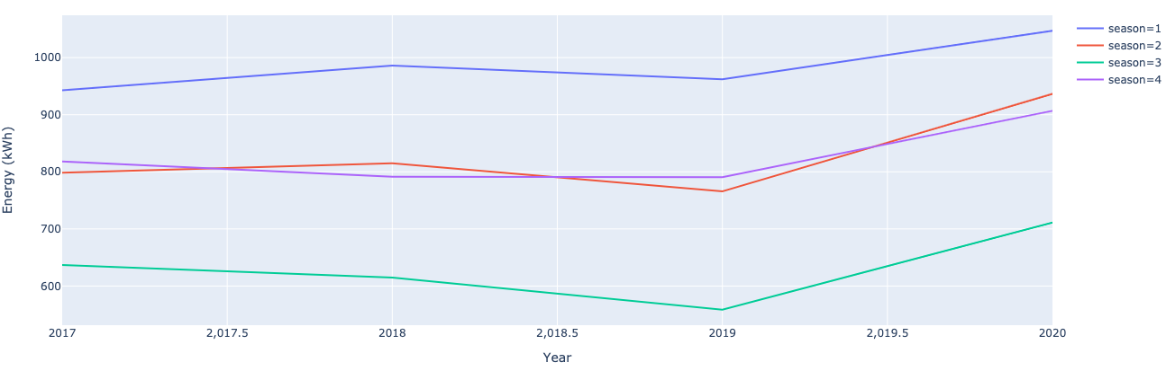
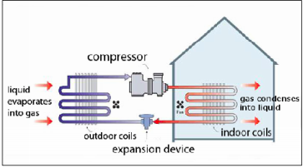
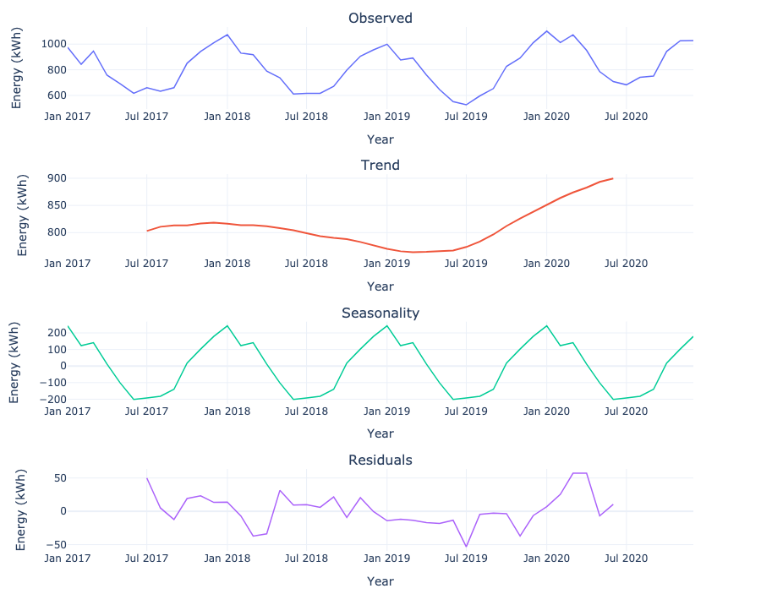
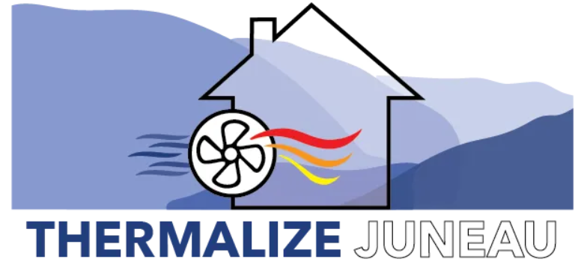
Establishment and Analysis of Baseline Electrical Data
for Thermalize Juneau 2021 Campaign
Isabella Chittumuri¹, Vanessa Stevens², Nathan Wiltse³, Tom Marsik⁴
¹CUNY Hunter College, ²Cold Climate Housing Research Center – National Renewable Energy Laboratory
Introduction
Materials and Methods
Discussion and Conclusion
What is Thermalize Juneau?
Clean-energy campaign consisting of 165 registered participants in Juneau, Alaska.
Provides free heat pump assessments and energy audits, bulk discounts and simplified installation process, and energy efficiency retrofits.
Data Processing:
Converted electrical consumption from billing period to reflect calendar month for 2017-2021.
Mean and five-number summary detected outliers.
By filtering and manipulating raw data, we established baseline electrical consumption data for Thermalize Juneau registrants.
Observed electricity consumption levels were higher in the beginning and end of the years and lower towards the middle.
Noticed an overall consistent linear trend incline, suggesting minor effects of Covid-19 during 2020.
Found consumption levels were significantly higher during winter and significantly lower during summer.
Fall and spring consumption levels stayed relatively in between the other two seasons.
Figure 1: Decarbonization in Juneau Preliminary Findings. Image courtesy of (EESI, 2021)
Figure 3: Monthly electrical consumption of all 165 Thermalize Juneau registrants
What is an air source heat pump (ASHP)?
Partially renewable heating appliance, also known as ductless heat pumps (DHP), that gathers heat from outdoor air.
Uses electricity to step up the heat from outdoor air and delivers it to indoor units.
Since Juneau’s electricity is generated by hydropower plants, ASHP are 100% renewable for this campaign.
Time Series Decomposition:
Used monthly median values for unbiased analysis.
Observed plot shows monthly median electricity consumption over time.
Trend plot represents the overall direction and long-term movement of the data values.
Seasonal plot represents yearly variations that are steady over time, direction, and magnitude.
Residual plot represents random unexplainable parts of the data.
Figure 4: Mean yearly electricity consumption average per season
Future Research
Though we did not find highly significant effects of Covid-19 shelter in place mandates for electrical consumption, we did not dismiss its possible effects for all energy usages. Future research involves cleaning and analyzing baseline Thermalize Juneau registrants’ fuel oil and biomass data. We will then use this baseline data to get a more holistic analysis of energy usage from 2017-2020.
Afterwards, we will compare it to post-retrofit data of 2021-2022 and verify if DHP produce real-world energy savings.
Figure 2: ASHP refrigeration cycle in heating mode. Image courtesy of (RETScreen, 2012)
Acknowledgements
Research Objectives
Process and establish baseline electrical consumption data
Study statistical time series analysis
Explore seasonal attributes and possible effects of Covid-19 shelter in place mandates
I would like to thank Vanessa Stevens, Nathan Wiltse, and Tom Marsik for their guidance on this project during this fall semester. This work was supported in part by the U.S. Department of Energy, Office of Science, Office of Workforce Development for Teachers and Scientists (WDTS) under the Science Undergraduate Laboratory Internships Program (SULI).
Figure 4: Time series decomposition of monthly median electricity consumption
This work was authored by the National Renewable Energy Laboratory, operated by Alliance for Sustainable Energy, LLC, for the U.S. Department of Energy (DOE) under Contract No. DE-AC36-08GO28308. Funding provided by U.S. Department of Energy Office of Science. The views expressed in the article do not necessarily represent the views of the DOE or the U.S. Government. The U.S. Government retains and the publisher, by accepting the article for publication, acknowledges that the U.S. Government retains a nonexclusive, paid-up, irrevocable, worldwide license to publish or reproduce the published form of this work, or allow others to do so, for U.S. Government purposes.
NREL Intern Symposium
Golden, CO
December 9, 2021
NREL/PO-5600-81686

